Slide 1

BARCODING OF BOXES TO ENSURE SYSTEM DRIVES FIFO ADHERENCE
Guide: Prof. Prashant Narayankar
Company Name: SPICER INDIA
Team: 38
Team Members:
NAME | USN
Amit Terdal | 01FE19BCS261
Rajesh Rathod | 01FE19BCS282
Yashasvi A R | 01FE19BCS224
Sneha H | 01FE20BCS405

Slide 2
Content
Introduction
Data Description
Motivation
Problem Statement
Objectives
Scope and Constraints
Requirement Analysis
System Design
Data Set
Modules of System Design
Use-Case diagram
Testing

Slide 3
Introduction
Dana Anand India Private Limited designs and manufactures drivetrain products for the OEMs of utility vehicles and commercial vehicles, off-highway and the related aftermarket segments, domestically and internationally. Continuous R&D and collaborative product development efforts have enhanced Dana Anand India’s trustworthiness among OEMs and fleet operators.
Spicer India manufactures parts which are then exported in different quantity.
It has 2 departments:
Foreign Export
Domestic Export

Slide 4
Data Description
Each box has fixed number of parts =200parts
The number of racks are from A1 to A64, B1 to B64, C1 to C64, D1 to D64, E1 to E64, , F1 to F64, , G1 to G64
Each container has fixed number of boxes=32 boxes

Slide 5
Motivation
The packing of manufactured parts is done manually. The generation of QR code for box is not automated.
Each box has a fixed number of layers, and each box can accommodate a certain number of parts.
The QR code must rewrite the previous QR code after completely filled with parts.
The products that are manufactured first should be exported first.
Tracking of boxes that is location of the box, manufactured date and part present in the box is done manually.
Tracking of boxes in which container which part of box is present.
This requires a lot of human effort and is prone to errors.

Slide 6
Problem Statement
To design and develop a web-portal to track the items which are stored and exported in FIFO format and create a database for the same.

Slide 7
Objectives
To generate a QR code for the products.
To track the items in the boxes.
To rewrite the QR code of pervious box which was not completely filled.
To track the location of the box in the rack.
To create a database to store all the information.
To update admin about the location of the earliest manufactured production on the basis of part-name.

Slide 8
Scope And Constraints
A corresponding mobile application can be developed that can scan the QR code generated to get the detailed information of the respective item.
The application can be improved by optimizing its performance.
New web-pages can be appended to existing website based on the increasing requirements of the industry.

Slide 9
Requirement Analysis Functional Requirements:
Admin shall be able to add new products to the database.
Admin shall be able to add the manufactured products into the database.
Admin shall be able to view the list of available products.
Admin shall be able to generate and retrieve the QR code of the products.
Admin shall be able to search for the availability of the products.
Admin shall be able to get location-id of the searched product which was added first to the database.
Rewriting of already existing QR code after completely filling a box.
Linking the QR code of the location to the particular box.

Slide 10
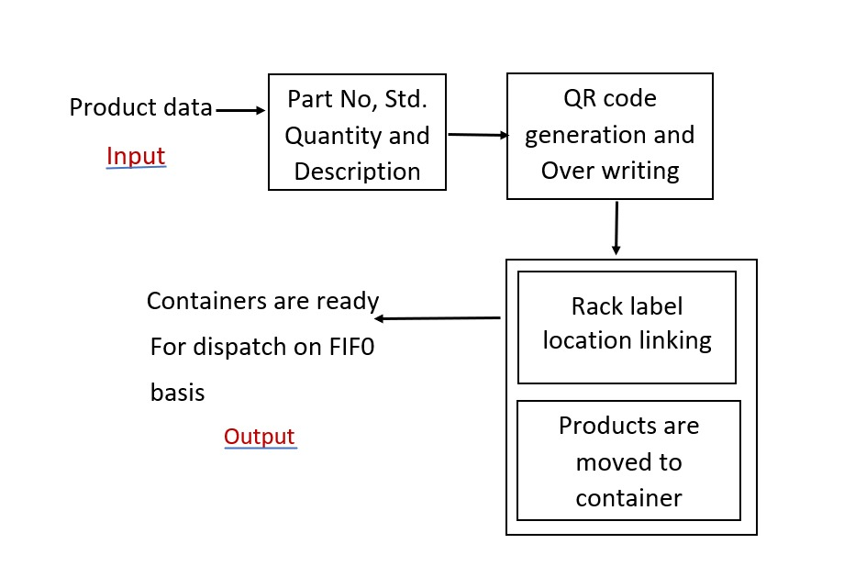
System Design:

Slide 11
DATA SET
Part Nos | Description | Std Qty
10078623 | TUBE YOKE | -
10122970 | TUBE YOKE | -
10131911 | ARMED TUBE YOKE FORGING | -
2-28-1697 | TUBE YOKE | 810
2-28-367 | TUBE YOKE | 990
10047308 | FLANGE YOKE | -
10047306 | #N/A | 490
10026551 | TUBE YOKE | 495
10042072 | TUBE YOKE | 495
10094186 | #N/A | 768
10083455 | END YOKE - FLANGED ASSEMBLY | 448
10048907 | ARMED TUBE YOKE | 768
35666-3 | #N/A | -
6-2-25 | FULL RND FLANGE YOKE | 100
AUSKU-1263 | 3 ARM TUBE FLNAGE | 250
6-28-347 | TUBE YOKE | 200
6-40-521 | TUBE SHAFT | 144
INSKU-100474 | TUBE FLANGE 105PCD -AUSKU-686 | 250
170-2-19 | FLANGE YOKE | 100
6.5-2-15 | FLANGE YOKE | -
2-40-1031 | TUBE SHAFT | -
4-28-417 | TUBE YOKE | 400
13449 | PIN - ROLL | -
6-40-541 | TUBE SHAFT | 144
90-2-15 | FLANGE YOKE | 100
90-2-29 | FLANGE YOKE | -
3052B14761 | CORPO FINITO 71B27 RL HF | -
3-4-14441-1 | END YOKE | 308
The part number and description of each part that is manufactured and the standard quantity of each part.

Slide 12
Sl nos | Part Nos | Std Box Qty
1 | 2-28-1697 | 810
2 | 2-28-367 | 990
3 | 10047306 | 490
4 | 10026551 | 495
5 | 10042072 | 495
6 | 10094186 | 768
7 | 10083455 | 448
8 | 10048907 | 768
9 | 6-28-347 | 200
10 | 6-40-521 | 144
11 | 4-28-417 | 400
12 | 6-40-541 | 144
13 | 3-4-14441-1 | 308
14 | 357-0597 | 162
15 | 357-0598 | 123
16 | 394-9495 | 308
17 | SKA19261 | 308
18 | 357-0596 | 162
19 | 10038887 | 338
20 | 2-4-7871-1 | 340
21 | 03-001410-001X | 288
22 | 26-001410-002X | 500
23 | 26-001410-003X | 405
24 | 3-40-1531 | 360
25 | 3-40-1961 | 520
26 | 1410X | 400
27 | 3-28-537 | 520
28 | 210391-1X | 200
29 | 3-28-267 | 800
30 | 3-3-118X | 392
31 | 211886-1X | 200
32 | 6-3-2671KX | 82
33 | 3-28-1717 | 810
The part number and the standard box quantity that is for each box there is a limited number of parts that should be added

Slide 13
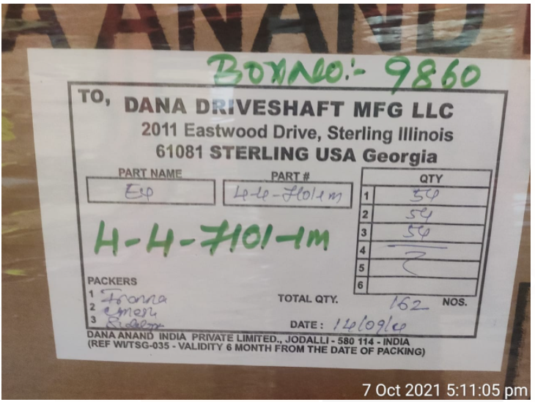
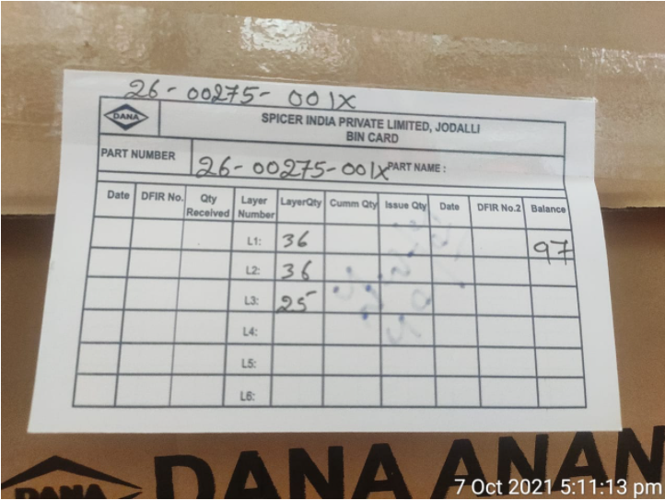
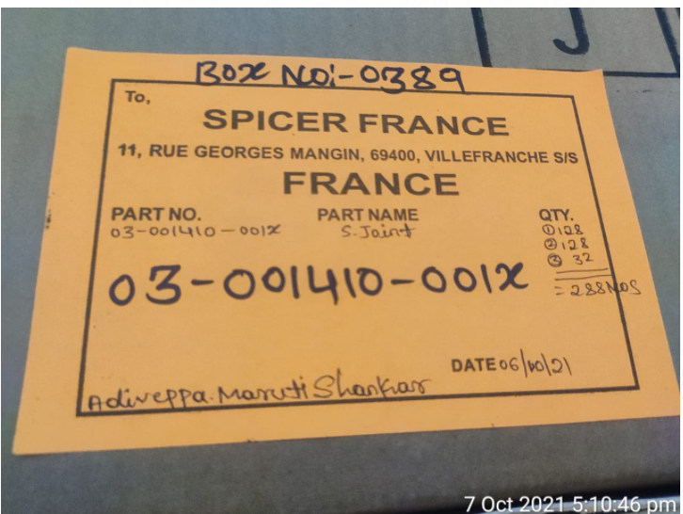
Tags

Slide 14
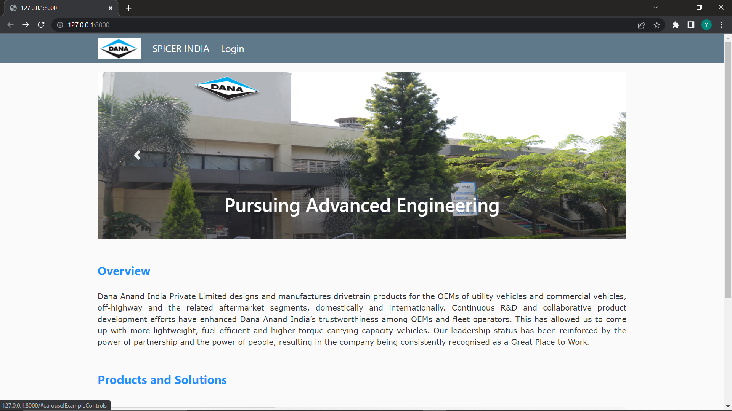
Homepage

Slide 15
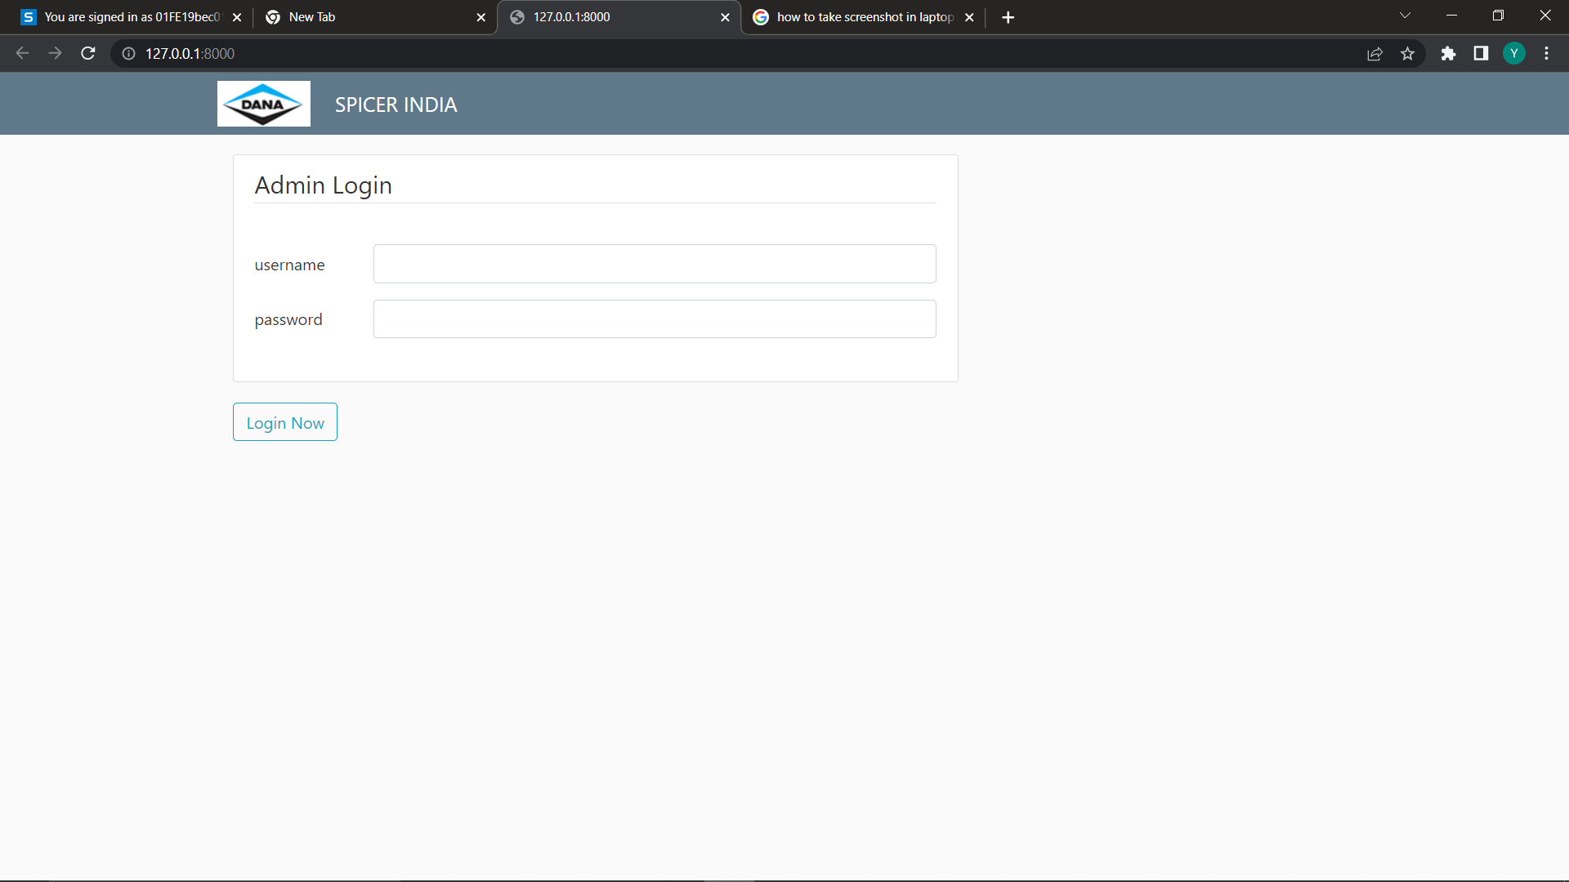
Authentication:
Log-in to the portal with admin credentials.

Slide 16
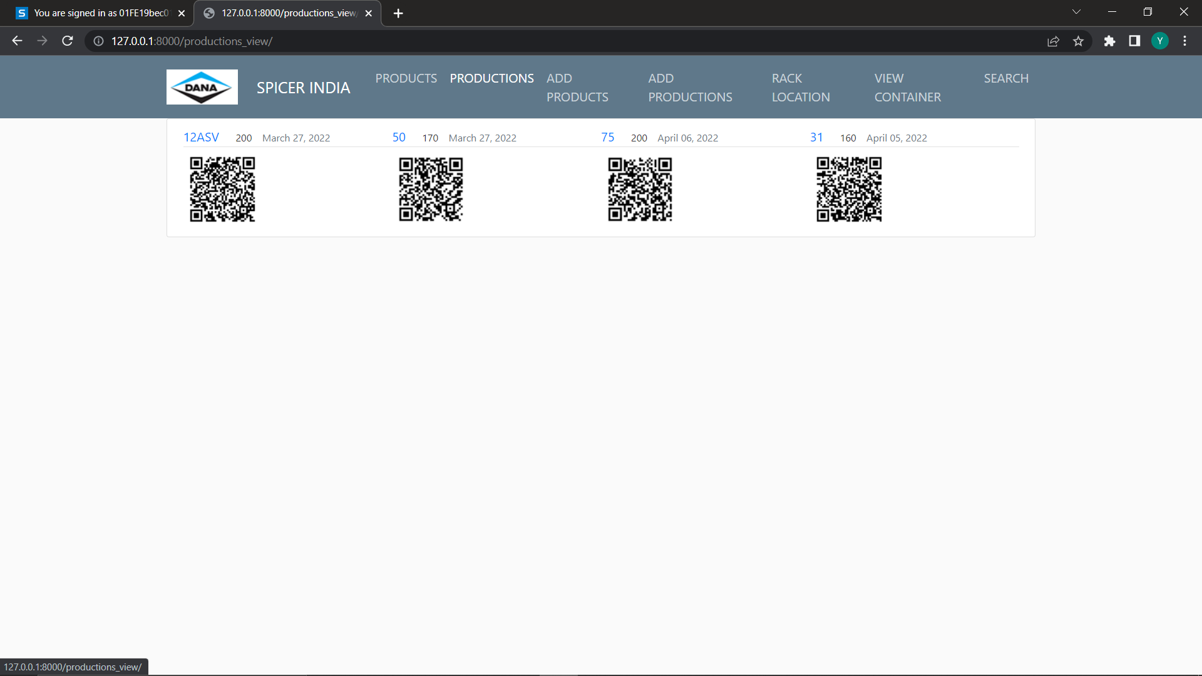
Production list:
The products produced and packed with their part-id, quantity, date-of-manufacture and its storage location.

Slide 17
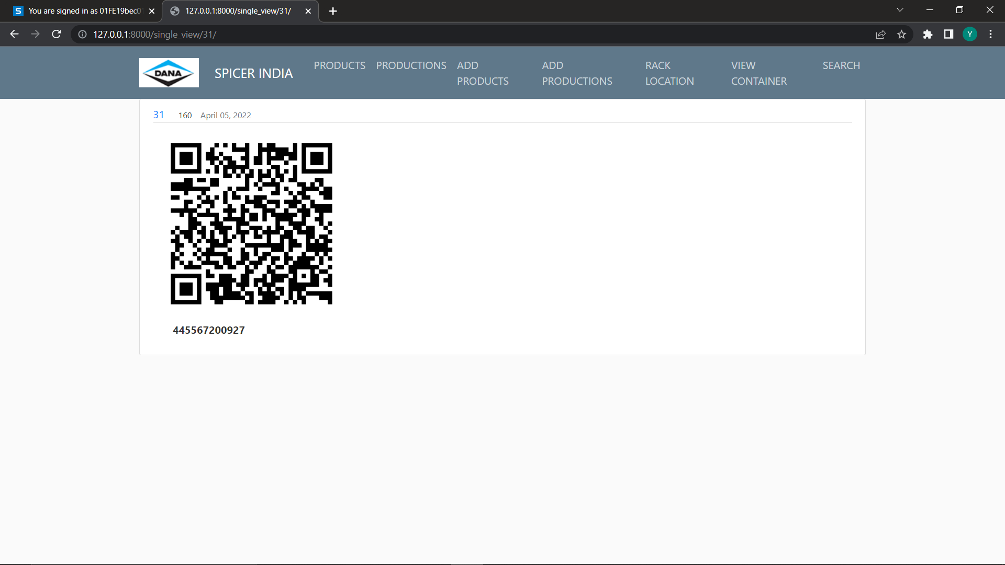
QR-code:
A unique QR-code is generated for each package with details.

Slide 18
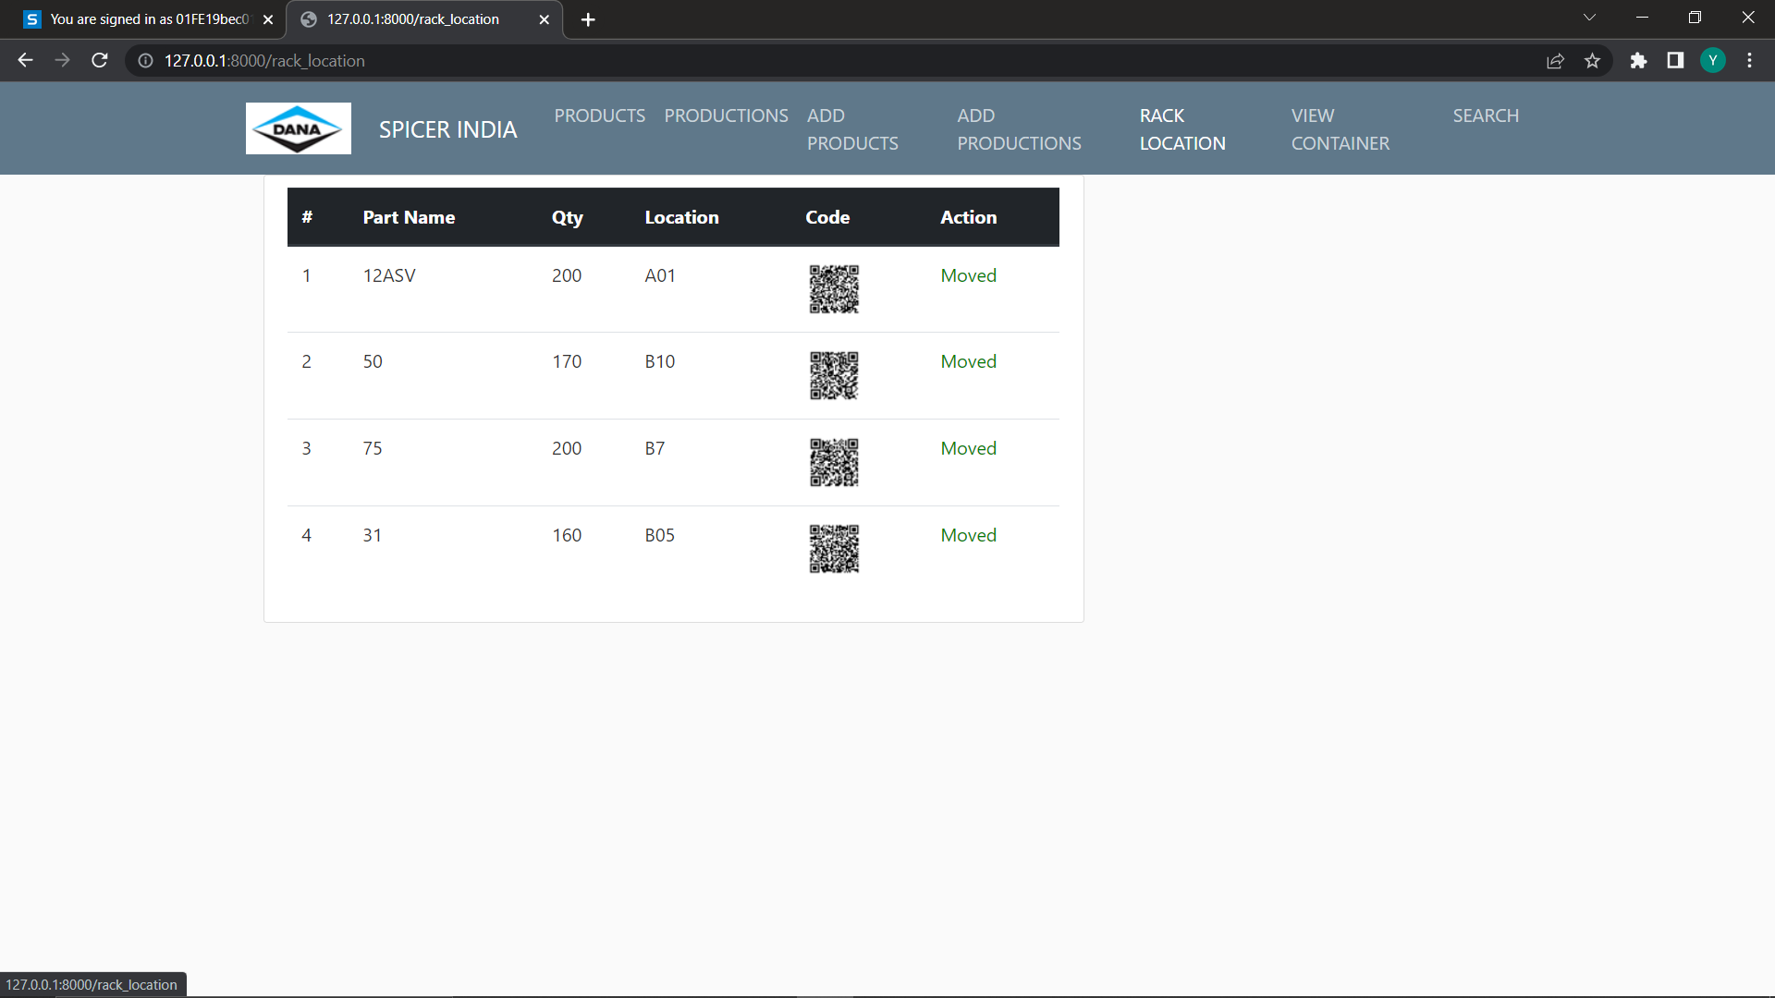
Rack locations

Slide 19
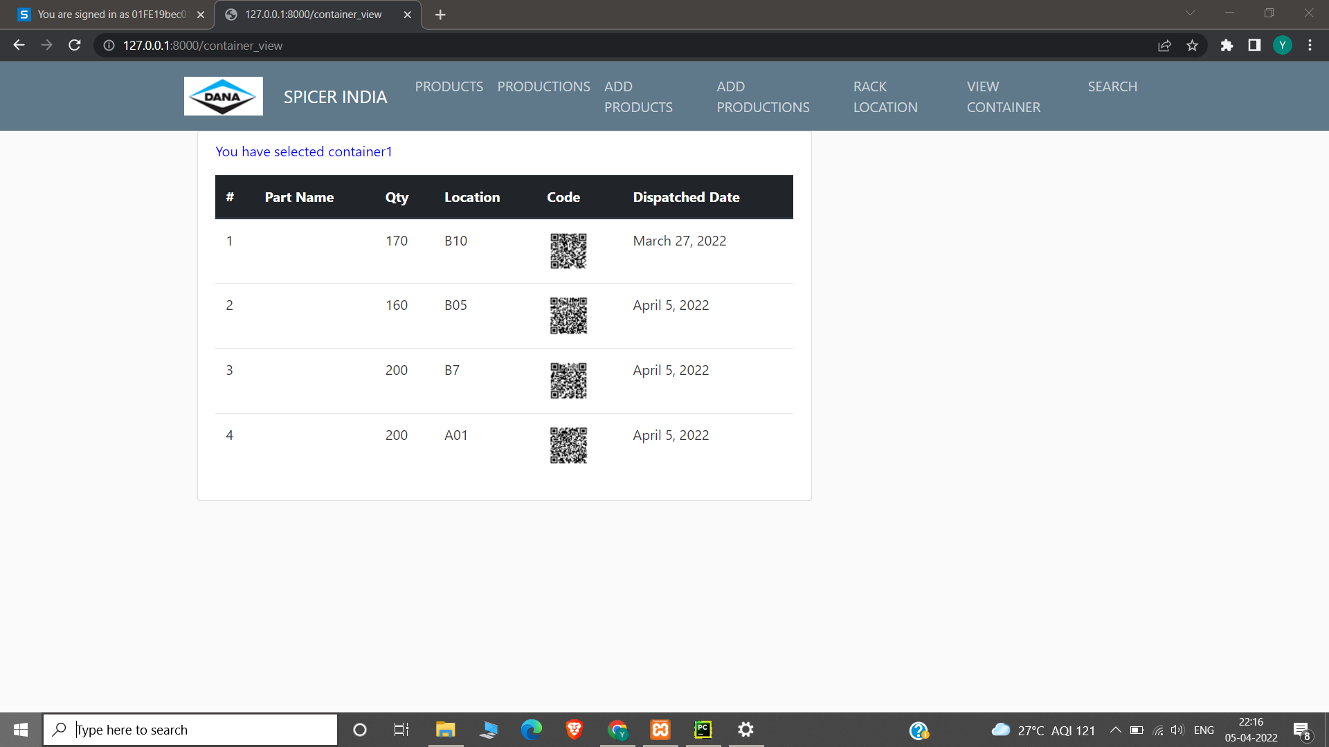
Containers:
Packages moved to containers are visible here.

Slide 20
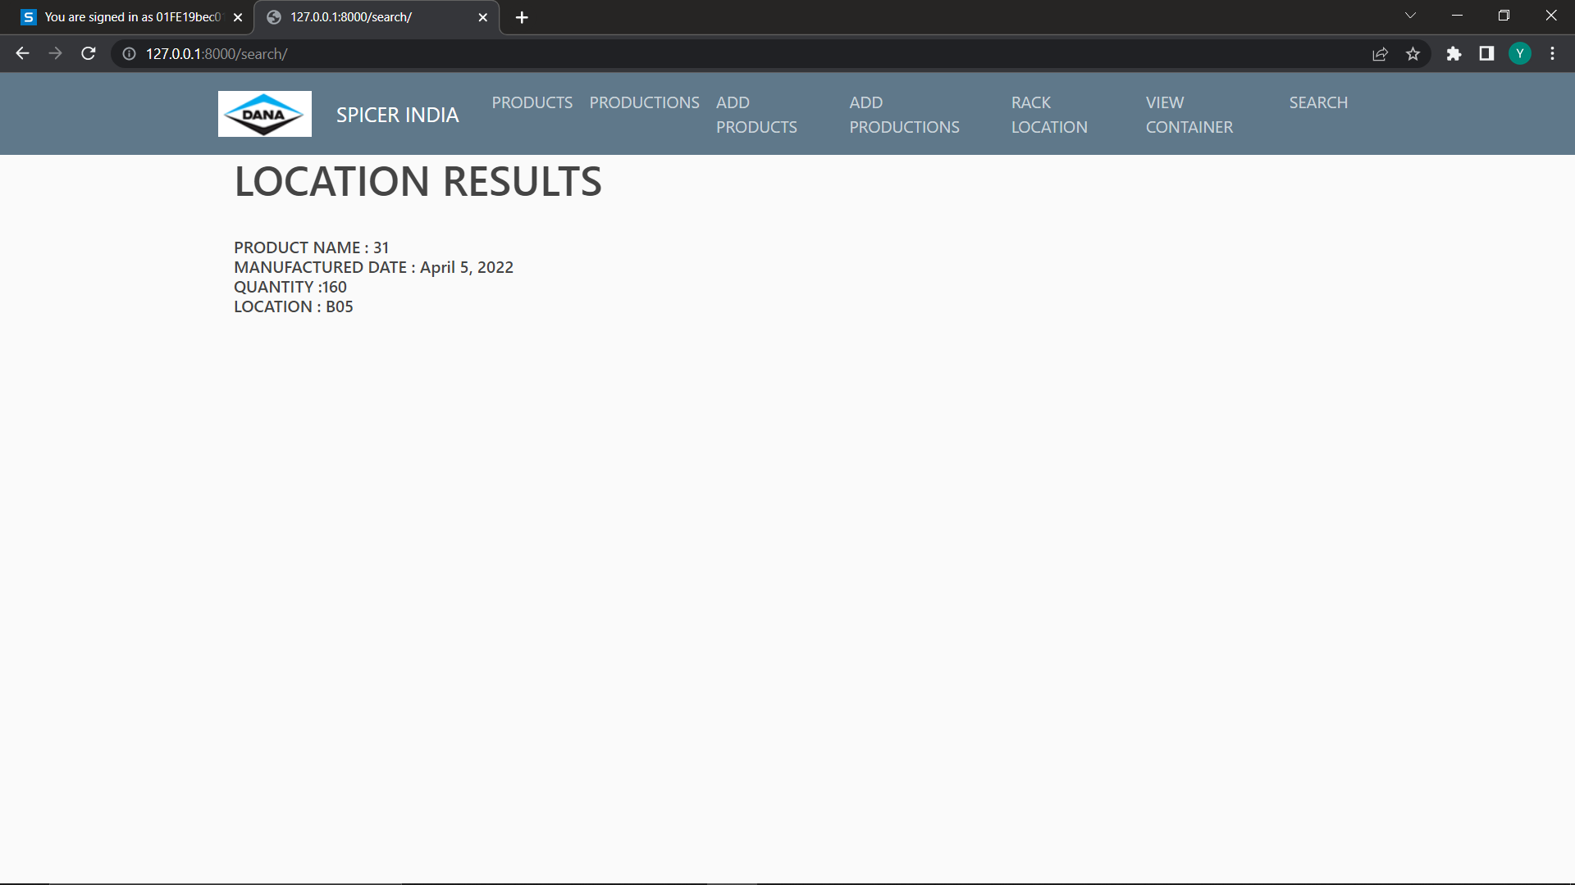
Selected products to be taken out adhering to FIFO:
The location from which a required product package is to be sent out first is mentioned.

Slide 21
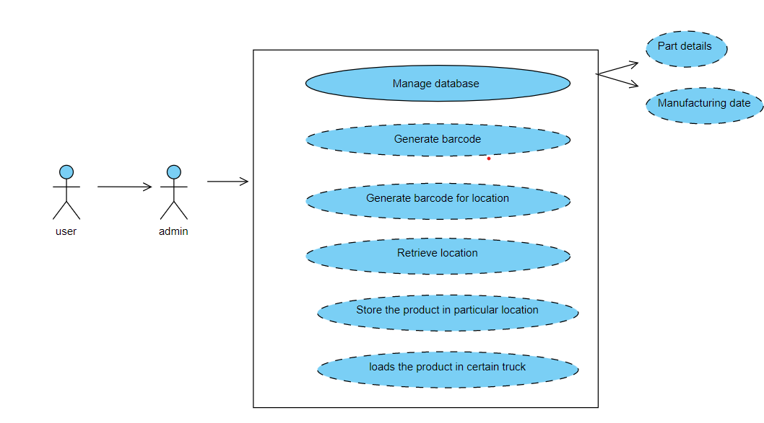
Use-Case diagram:

Slide 22
Thank You

